Slide 1

PORT
AUTHORITY
NY · NJ
Port Authority of
New York & New Jersey
Traffic Analytics
& Forecasting Project
GROUP 1
Harshita Bajaj
Final Project Progress Report · Spring 2026
Harshith Doli
BANL-6100-03 · University of New Haven
Khan Mazen Moid
Manjil Adhikari
Meghana Lakshminarayana Swamy
Under the Guidance of
Dr. Pindaro Demertzoglou

Slide 2
Business Goals & Objectives
📊 Traffic Factor Analysis
Identify the top factors affecting daily facility usage — weather, gas prices, severe storm events, seasonality, and vehicle mix.
🚨 Toll Violation Reporting
Measure violation patterns by facility and time period (year / month / week) to support enforcement and revenue planning.
🌀 Congestion Pricing Impact
Analyze 2025 congestion pricing changes vs. prior years to detect behavioral traffic shifts across facilities.
⏰ Analysing Busiest Times
Identify the busiest times throughout the year and how traffic is affected by seasonality, toll violators, type of car, and other factors.
🔮 Forecast Beyond 2025
Use AutoTS to identify the best forecasting model and deploy results through an interactive web application and Power BI dashboard.

Slide 3








Tools & Technology Stack
ANALYSIS & MODELING
MODEL DEPLOYMENT
Python
Python
Anaconda / Jupyter Notebook
Advanced Modeling & Deployment Prep
R
FastAPI
EDA & Statistical Analysis
REST API — Real-time Predictions
SQL
Docker
SQLiteOnline — Data Integration
Containerization of Model + API
H2O.ai AutoML
Kubernetes
Automated Model Selection
Minikube — Scalable Cluster
Power BI
Vercel
Interactive Dashboards
Web App Deployment

Slide 4
Dataset Selection — Why These 5?
INTERNAL
EXTERNAL
✔ All Recorded Traffic
✔ NOAA Daily Weather
29,334 rows (daily, facility-level)
4,018 rows · Newark Airport
Primary dataset — measures daily vehicle counts, Cash vs EZPass split, toll violations across all 8 facilities. This is our target variable source.
Weather is a primary traffic driver. Temperature, precipitation, and snow directly suppress or shift travel demand.
✔ Facility Mobility Speeds
✔ NOAA Storm Events
5,975 rows (daily)
4,018 rows · NY & NJ only
Provides Avg_Speed and Delta as congestion indicators. Lower speed = higher congestion. Key explanatory feature for regression and forecasting models.
Adds SevereFlag (0/1) and event count per day — essential for measuring extreme weather impact on traffic volume.
✘ Excluded Datasets
✔ EIA Gas Prices
PABT Passenger & PABT Bus
3,895 rows · East Coast PADD 1
Terminal-specific bus data — not aligned with bridge and tunnel forecasting.
Gas price drives travel behavior. Captures 2015–16 lows, COVID dip, and 2022 spike — strong economic signal for the model.

Slide 5
Phase 2 — Predictive Models Built
Three models were developed using H2O AutoML and AutoTS to answer the five business questions
🔢 Regression Model
🔵 Classification Model
📈 Time Series Forecast
H2O AutoML · Stacked Ensemble
H2O AutoML · Gradient Boosting (Bernoulli)
AutoTS · Horizontal Ensemble
● R² = 0.9791
● AUC = 0.9985
● SMAPE = 5.23%
● RMSE = 2,718 vehicles/day
● F1 = 0.9711
● 2,922 days forecast
● 282 models evaluated
● Recall = 96.79%
● 2025 – 2032
Predicts daily total_vehicles per facility. Identifies top 5 factors affecting bridge and tunnel usage. Feature importance used to answer Q1.
Predicts high_violation days (binary) — violation rate > 6.18%. Enables proactive enforcement scheduling with only 1.02% false alarm rate.
Trained on 28,360 daily records (2015–2024). Forecasts yearly vehicle counts per facility through 2032 using 2 backwards rolling validation windows.
Answers: Q1, Q3, Q4
Answers: Q2
Answers: Q5

Slide 6
Phase 2 — Model Deployment
FastAPI + Docker + Kubernetes (Minikube) on Windows 11 with WSL2
🧠
⚡
🐳
☸️
🌐
H2O MOJO
Models
→
FastAPI
Backend
→
Docker
Container
→
Kubernetes
Minikube
→
Live
Endpoints
API Endpoints Deployed
GET /
Health check — confirms API is running
POST /predict/regression
Predicts daily vehicle count for a given facility-date
POST /predict/classification
Predicts high_violation probability for a facility-day
POST /predict/timeseries
Returns AutoTS forecast for selected facility and date range
✅ Docker image deployed on Minikube · Pod running 1/1 · Service accessible via Minikube URL

Slide 7
📊
Let's Explore Our
Power BI Dashboard
Interactive analytics across all business questions

Slide 8
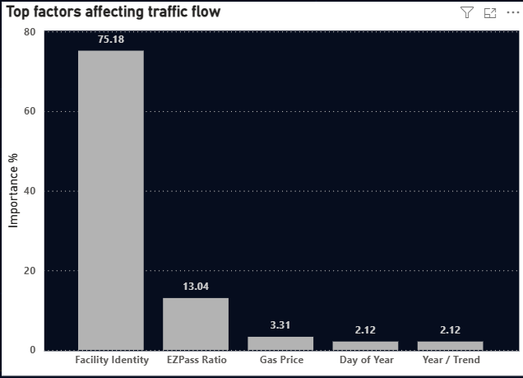
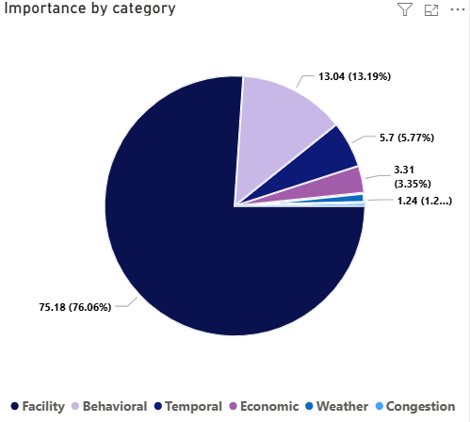
Top 5 Factors Affecting Bridge & Tunnel Usage
H2O AutoML · Stacked Ensemble | R² = 0.9791
75.18%
13.04%
0.9791
2,718
Facility Identity
(Top Factor)
EZPass Ratio
(2nd Factor)
Model R²
RMSE (vehicles/day)
Key Findings
● Facility Identity dominates at 75.18% — GWB Upper (28M/yr) vs Bayonne (4.3M/yr)
● EZPass Ratio (13.04%) is the most actionable lever — higher adoption = higher stable volume
● Gas Price (3.31%) is the key economic sensitivity signal
● Temporal features (Day of Year, Year, Day of Week, Month) account for 5.7% combined
● Weather features (Snow, Temp) contribute <1.25% — operational, not structural

Slide 9
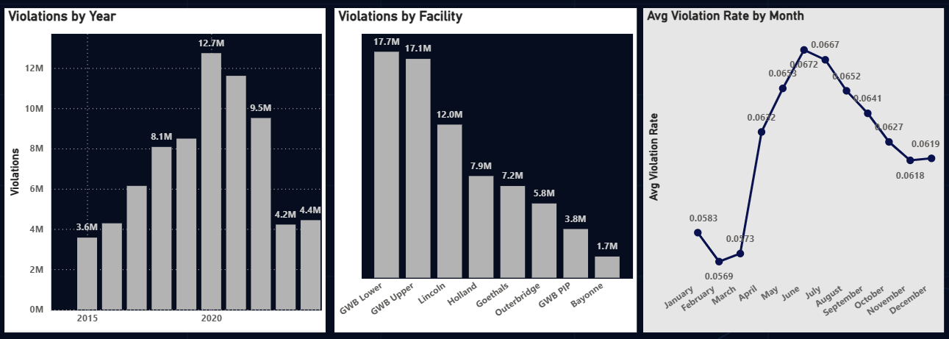
Toll Violations by Time Period & Facility
H2O AutoML · Gradient Boosting | AUC = 0.9985
0.9985
96.79%
0.9711
31.08%
Model AUC
Recall Rate
F1 Score
High Violation Days
Peak: 2020 — 12.7M violations · GWB Lower highest (17.7M total) · Summer months peak at 6.72% rate

Slide 10
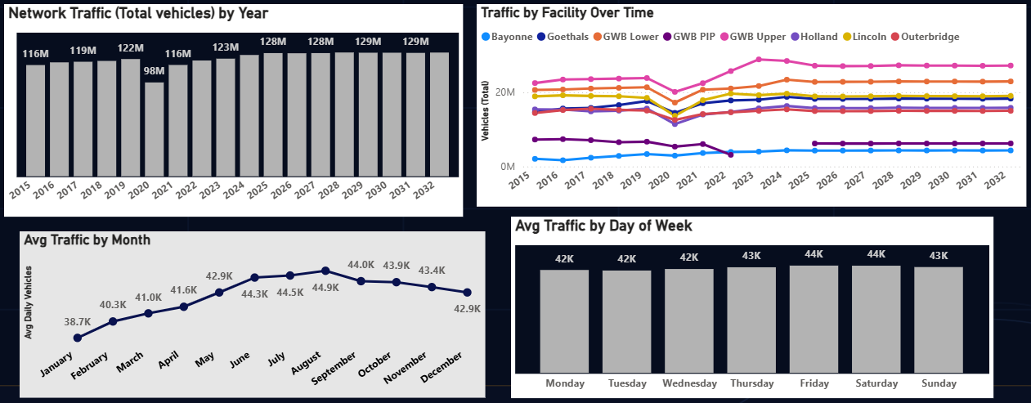
Busiest Times & Seasonal Traffic Patterns
H2O AutoML · Stacked Ensemble | R² = 0.9791
2023
Jun–Aug
−26.83%
+30.84%
Peak Year
(128.7M vehicles)
Peak Season
(44K–44.9K/day)
COVID Drop
(Holland 2020)
Best Recovery
(Lincoln 2021)
2020 COVID shock: −20.5% network-wide · Bayonne doubled 2015→2024 · Friday/Saturday peak day-of-week

Slide 11
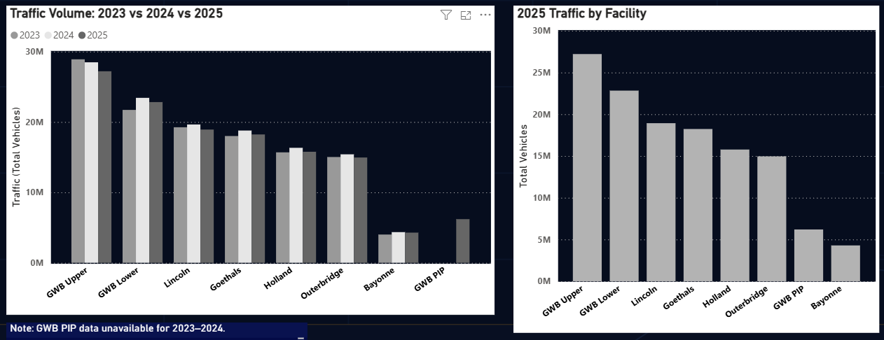
Congestion Pricing Impact in 2025
H2O Regression + AutoTS · Horizontal Ensemble
Jan 2025
−1.46%
GWB Upper
GWB Lower
Congestion
Pricing Start
GWB Upper
YoY 2024
Highest
Declining Facility
2025 volume Increase
GWB Upper only facility with negative 2024 growth · Bayonne (+19.3%) and Goethals (+14.6%) are forecast beneficiaries

Slide 12
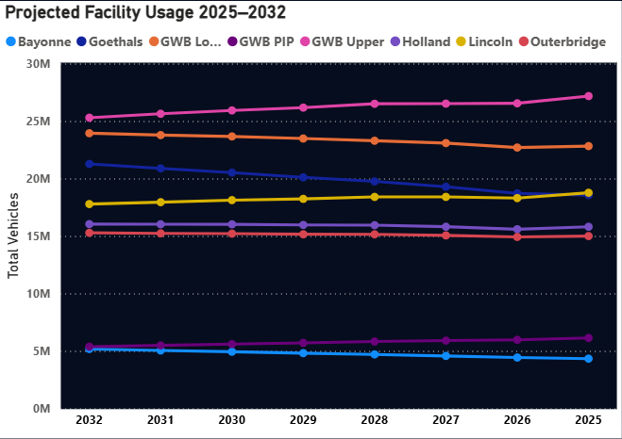
Facility Usage Forecasts 2025–2032
AutoTS · Horizontal Ensemble | SMAPE = 5.23%
5.23%
Bayonne
GWB Upper
2032
Best SMAPE
(Validation)
Fastest Growing
+19.3% by 2032
Declining Facility
−7.0% by 2032
Forecast
Horizon
Forecast Summary (Millions)
Year Bayonne GWB Up. Goethals
2025 4.33 27.17 18.56
2028 4.69 26.50 19.75
2032 5.17 25.29 21.27
● Bayonne — only facility growing every year
● GWB Upper declining from 27.2M to 25.3M
● Goethals gains from congestion pricing diversion
● Lincoln moderate decline (−5.2%)

Slide 13
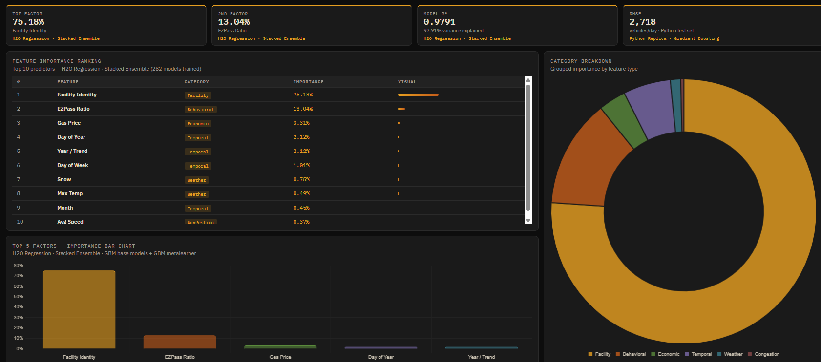
Live Web Application — Deployed on Vercel
🌐 https://port-authority-ny-nj-traffic-flow-c.vercel.app
App Features
📊 5 Question Pages
One per business question with interactive charts
🔽 Live Filters
Facility, Year, and Metric Focus filters
💡 Dynamic Insights
Insight strip updates based on filter selections
🗄️ Supabase Backend
16 pre-computed analytics tables
🏷️ Model Attribution
Every chart shows which model produced the result
Future Scope: Can be connected to a live Port Authority API — all charts update automatically when new data is available

Slide 14
Thank You
Questions & Discussion
Port Authority of New York & New Jersey · Group 1 · Spring 2026

